Slide 1


Slide 2
INTRODUCTION
Problem Statement:
In a traditional system for buying the goods of constructional material, we go for a physical store and shop them, and if we want a service of different type of labour we go to the nearest point for picking a labour services they are not a trusted person and if we want to sell the home we go to the property dealer for a selling purpose.
Introduction:
Buy construction material goods.
Trusted labour
Buy & sell house.

Slide 3
Product Features:
Construction Material.
Home Renovation Products.
Get Labour Services.
Check daily price list
Buying and Selling Houses.
Track Order.

Slide 4
Purpose:
Our Purpose is to create a website , in which customer can order any product that use for house building such as Construction , Material , Tilling and flooring and also get a services of different kind of Labour Services such as painter, Carpenter, Electrician etc. Customer using our website and get the material and services at your door step. We also provide a Service to Buy And Sell House there are two types of house first one is our own making house and the second one is customer they can also add house on our site to sell.

Slide 5
Objectives:
To provide the desire and quality product as per customer need.
Customer can purchase Products Online at door step easily .
Customer can get the trust worthy labour.
Customer can sell your own home while setting at home.
Data security is maintained to a relatively high level.

Slide 6
Scope:
Over target audience is those people who want to buy material that use for home building and
for renovation of house.
Those people who want a labour services at door step services such as painter, carpenter labour.
Customer Buy and Sell House.

Slide 7
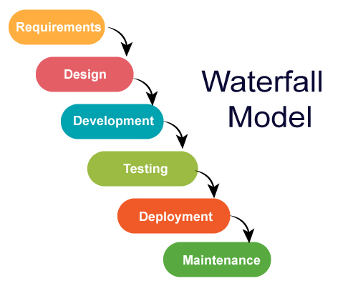
METHODOLOGY

Slide 8
Requirements:
Planning & Design:
Development:
Testing:
Deploment
Maintenance

Slide 9




Tools :
Visual Studio Code
Draw.io
Corel-Draw
DB Browser for SQLite3

Slide 10






Technology (Language & Framework) :
HTML
CSS
Bootstrap
JavaScript
Python
Django Framework

Slide 11
System Requirements:
Windows 7,8,10,11
Intel Core Processes and AMD Processes
RAM 2GB Minimum
Hard Drive 80GB Minimum

Slide 12
Results: Till now in the market there is no platform that give all the services of ecommerce like buying constructional material, labor Services, sell property. We are trying to make best platform that fulfil the needs of customer on a single platform.
We Develop GHAR BANAO website.
A platform where a customer can easily buy constructional material get different kind of labor services or sell their property and earn money to give their facility with the help of our platform.

Slide 13
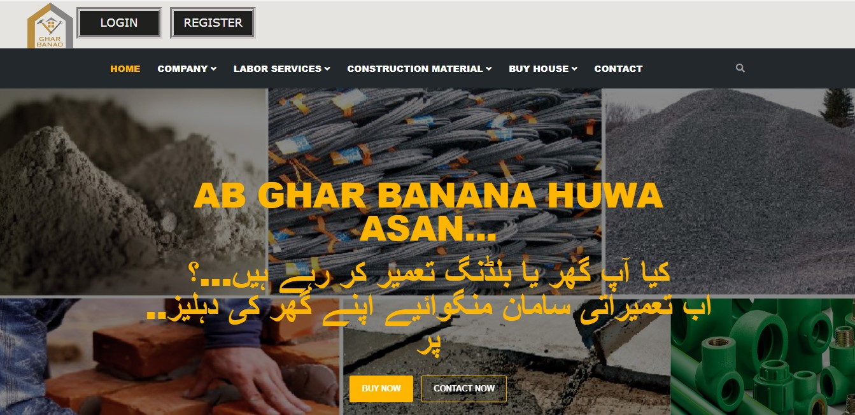
Home Page

Slide 14
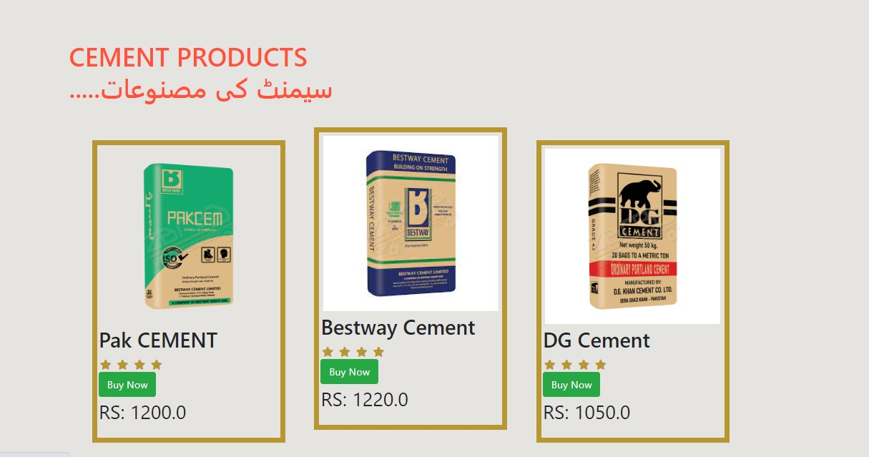
Construction Material Product

Slide 15
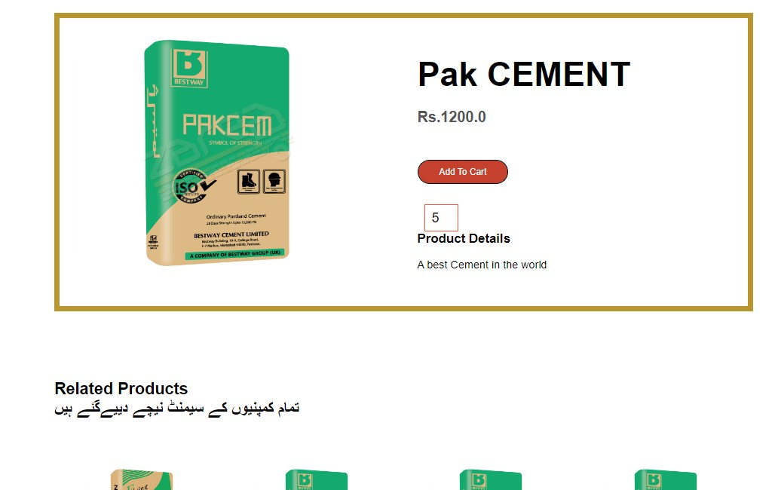
Construction Material Product description

Slide 16
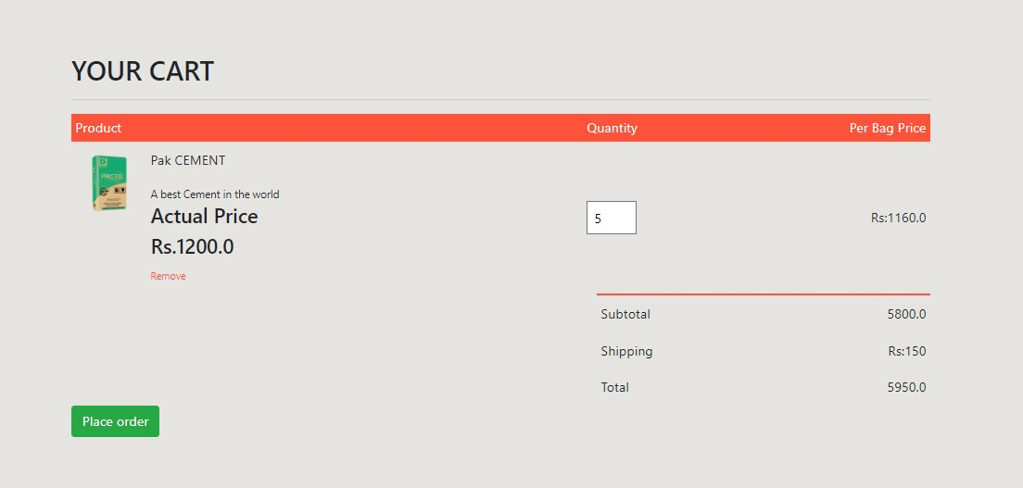
Construction Material Product Cart

Slide 17
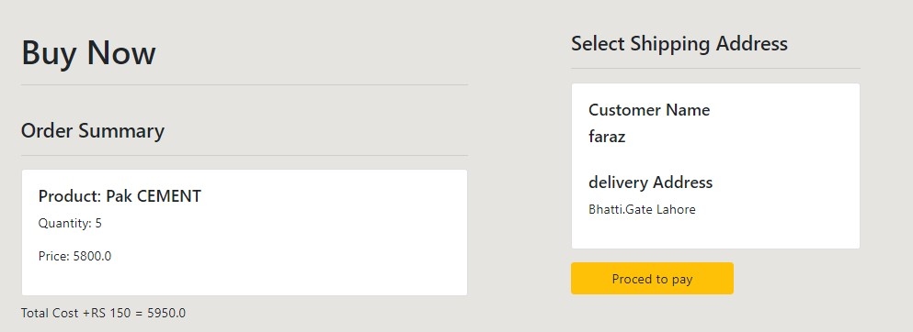
Construction Material Product Checkout

Slide 18
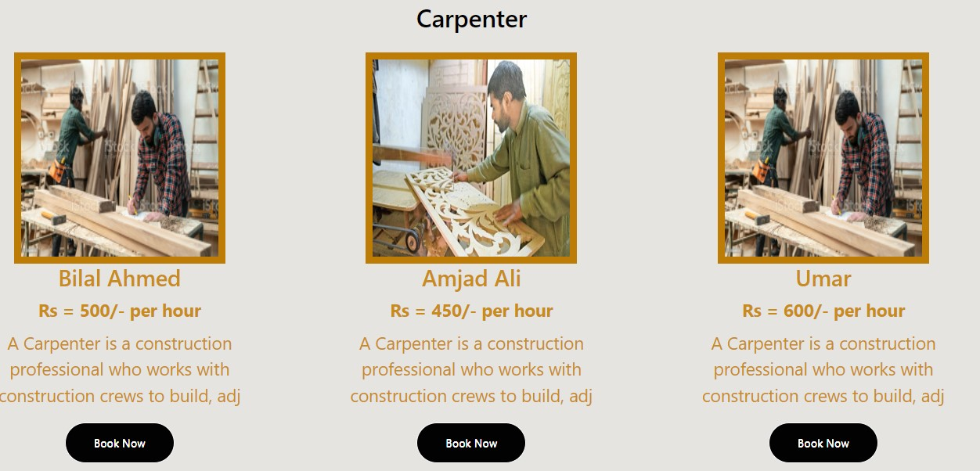
Labor Services

Slide 19
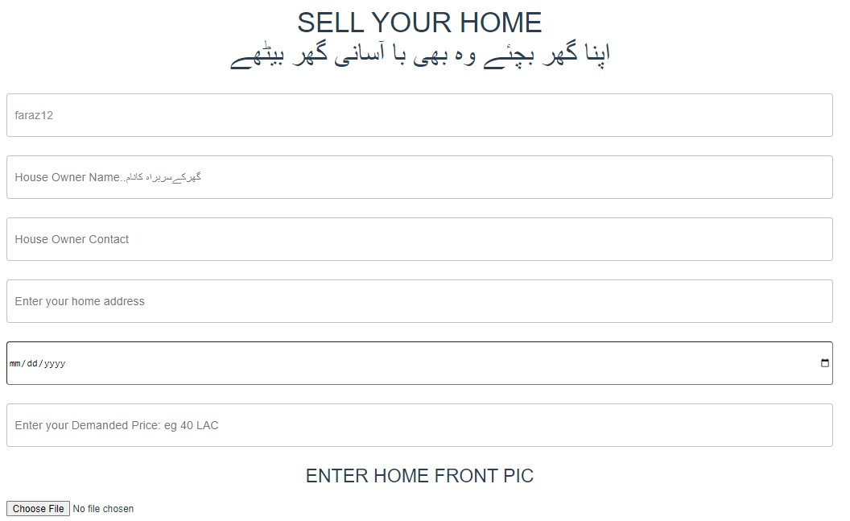


Slide 20
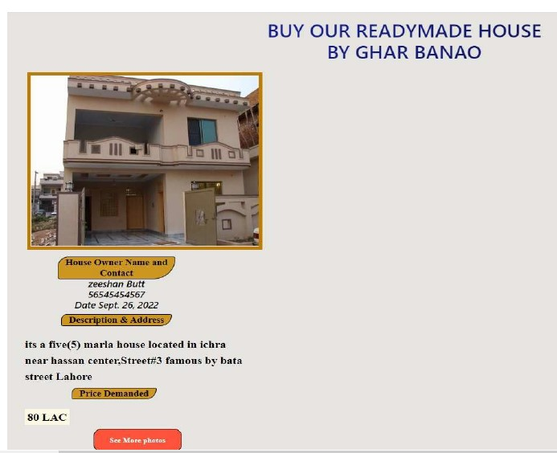
Buy & Sell House

Slide 21
Conclusion:

Slide 22


From:
GHAR BANAO TEAM

